Slide 1
Samsung Innovation Campus

Slide 2
Traffic Sign Recognition System
18-Dark Web Crusaders

Slide 3
Traffic Sign Recognition System
UNIT 1. Introduction
1.1. Intro
1.2. Background Information
1.3. Methodology
UNIT 2. Pre-Processing
2.1. Data Acquisition
2.2. Why Pre-Processing?
2.3. Pre-Processing Methodology
UNIT 3. Model
3.1. Model architecture
3.2. Evaluation
3.3. Interface and testing
3.4 Future Improvements
Notes:
Note:

Slide 4
What is Traffic Sign Recognition?
1.1. Intro
Traffic Sign Recognition
Traffic Sign recognition is very important and could potentially be used for driver assistance to reduce the accidents in driverless cars. Traffic sign detection and recognition is an important feature for driver assistance, contributing to safety of drivers, pedestrians and vehicle.

Slide 5
Why Traffic Sign Recognition?
1.2. Background Information
Background Information
Traffic Signs play a significant role in managing the traffic on the roads, avoiding any kind of road accidents and ensuring the safety of people by conveying different rules that need to be followed on the road. The annual globe roach crash statistics say that over 3280 people die every day in a road accident.

Slide 6
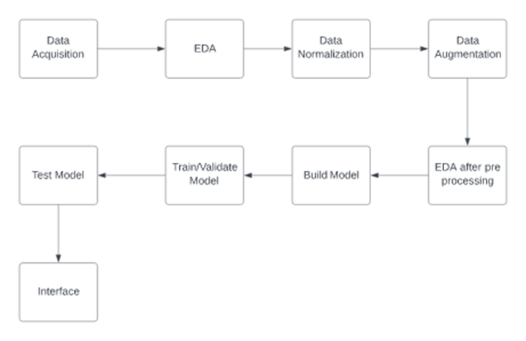
1.3. Methodology
Methodology
The steps which will be followed during implementation method are as follow:
1. Exploring Generalized Traffic Sign Dataset
2. Building a CNN Image recognition model
3.Training the model along with validations
4.Testing the trained model via test dataset

Slide 7
Traffic Sign Recognition System
UNIT 1. Introduction
1.1. Intro
1.2. Background Information
1.3. Methodology
UNIT 2. Pre-Processing
2.1. Data Acquisition
2.2. Why Pre-Processing?
UNIT 3. Model
3.1. Model architecture
3.2. Evaluation
3.3. Interface and testing
3.4 Future Improvements
Notes:
Note:

Slide 8
Dataset Used
2.1. Data Acquisition
German Traffic Sign Recognition Benchmark
There are many generalized dataset of Traffic Signs are available such as GTSRB, GTSDB, BTSCB, BTSDB. But the most common dataset is the GTSRB (German Traffic Sign Recognition Benchmark) dataset because it contains large number of traffic signs images (50,000 images and 43 classes) of different variety, background, and color variation which help to model to perform accurately. The dataset is further spilt into training, testing and validation dataset. The training dataset is used to train the model. The validation dataset is used to evaluate the model. The test dataset is used to check whether the model make correct predictions or not and it is only used once the model is trained.

Slide 9
Why did we need pre-processing?
2.2. Why Pre-processing?
Normalization
The issue of images being dark and of low contrast makes many signs hard to recognize.
There is little variation in the sign shape and viewing angle. Most of the pictures are taken with a straight on view of the sign, which is good for the core data set. However, in real life, signs are viewed from different angles.

Slide 10
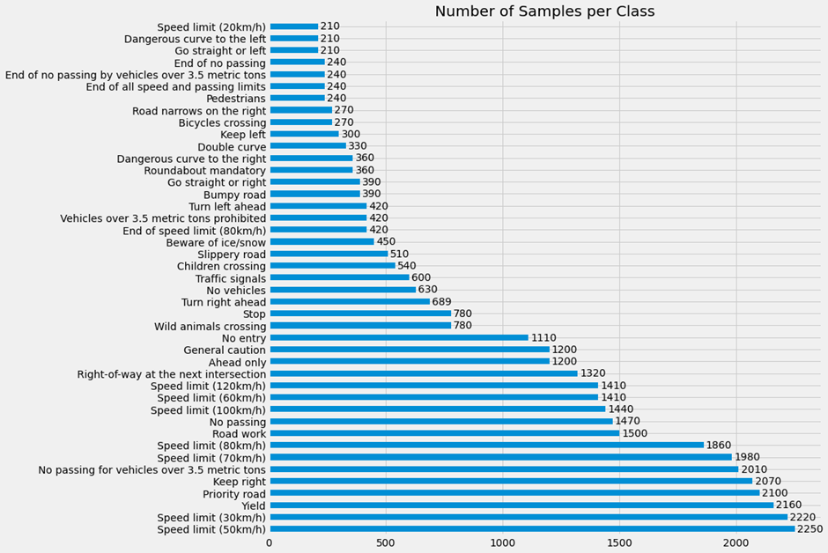
Why did we need pre-processing?
2.2. Continued…
Augmentation
As you can see in the given picture, the distribution is not uniform. The largest classes have 10x the number of traffic sign images than the smallest classes. This is expected given that in real-life there are certain signs which appear more frequently than others. However, when training the model, a more uniform distribution is desirable so that each class has the same number of training examples and the model

Slide 11
Traffic Sign Recognition System
UNIT 1. Introduction
1.1. Intro
1.2. Background Information
1.3. Methodology
UNIT 2. Pre-Processing
2.1. Data Acquisition
2.2. Why Pre-Processing?
UNIT 3. Model
3.1. Model architecture
3.2. Evaluation
3.3. Interface and testing
3.4 Future Improvements
Notes:
Note:

Slide 12
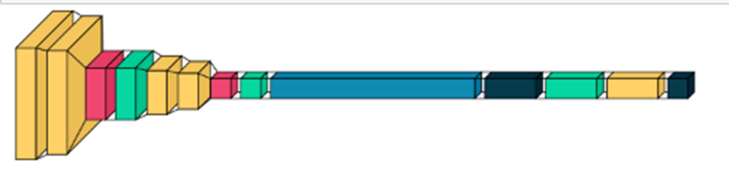
CNN Model Architecture
3.1. Model Architecture
Layers
We tested a variety of model. Ultimately, we settled on a relatively small and simple architecture that was easy to train and still delivered great performance. My final model consisted of the following layers:
1st Layer
2nd Layer
Dense Layer

Slide 13
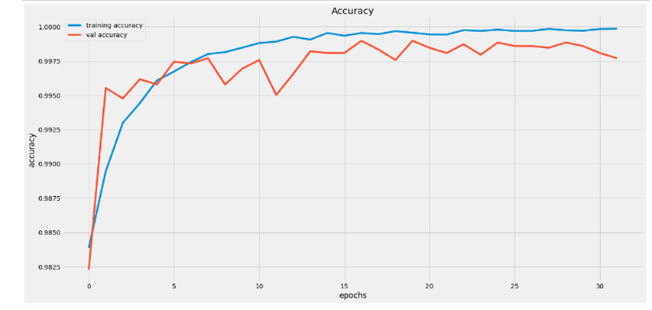
Accuracy of Model
3.2. Evaluation
Training and Validating Accuracy
We trained our model on pre-processed training data and got 100% accuracy. Upon validating the model on validation set, we got 99% accuracy

Slide 14
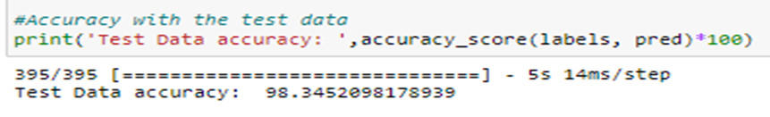
Accuracy of Model
3.1. Continued…
Testing Accuracy
On testing our model on testing set, we got 98.34% accuracy

Slide 15
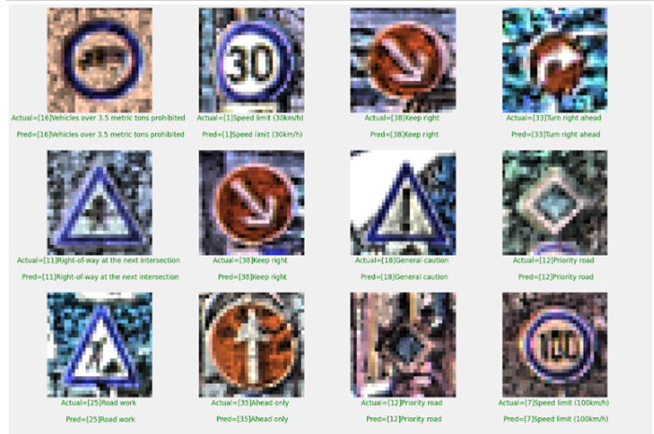
Accuracy of Model
3.1. Continued…
Final Model Results
training accuracy: 100%
validation accuracy: 99%
test accuracy: 98.34%

Slide 16
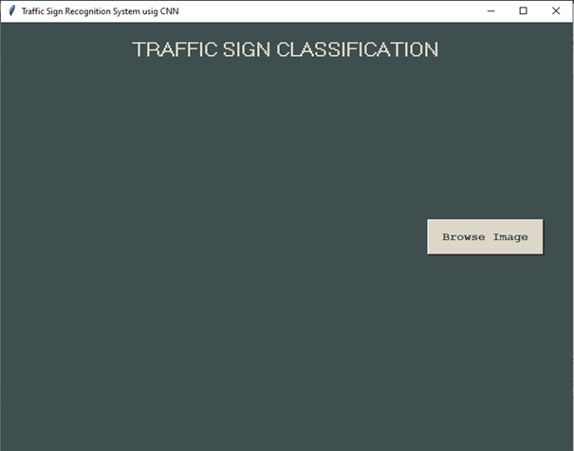
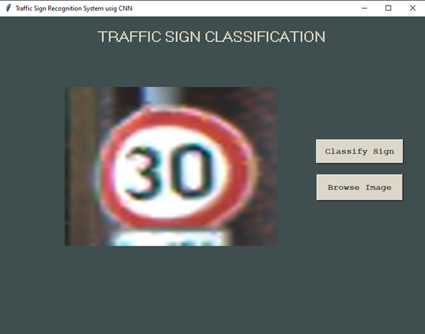
Interface using Tkinter
3.3. Interface
Tkinter
Tinkter is a GUI toolkit in the standard python library.
Then we build a GUI for uploading the image and a button is used to classify which calls the classify () function.

Slide 17
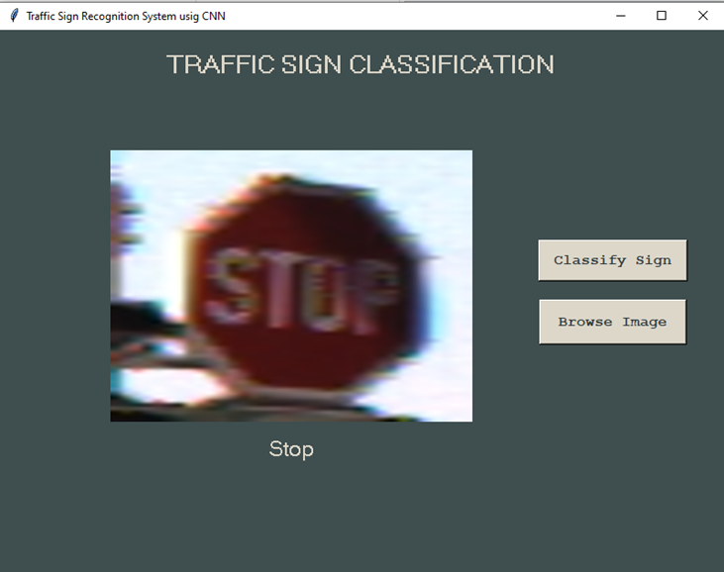
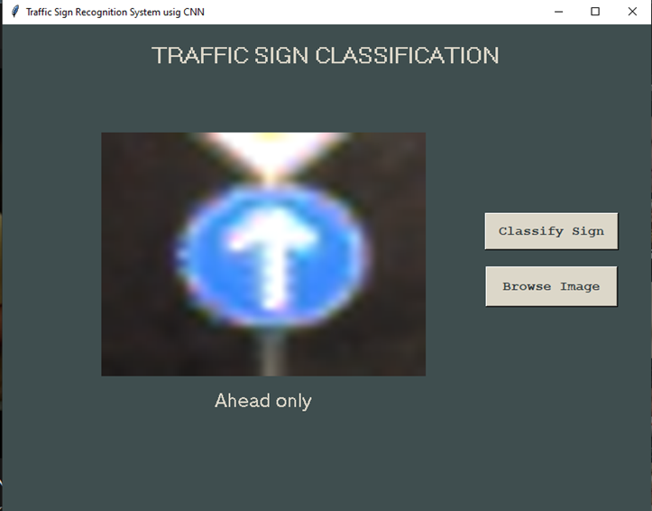
Interface using Tkinter
3.3. Continued…
Testing the Interface
. Here are some more outputs.

Slide 18
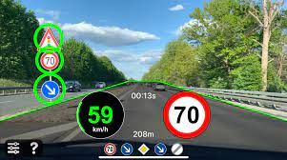
Future Improvements
3.4. Future Improvements
Environmental Constraints
High errors for similar looking signs
Video based Recognition System
Real time processing

